Slide 1
Azure OpenAI

Slide 2
Generative AI
Artificial Intelligence
1956
Artificial Intelligence
the field of computer science that seeks to create intelligent machines that can replicate or exceed human intelligence
Machine Learning
1997
Machine Learning
subset of AI that enables machines to learn from existing data and improve upon that data to make decisions or predictions
Deep Learning
2017
Deep Learning
a machine learning technique in which layers of neural networks are used to process data and make decisions
Generative AI
Create new written, visual, and auditory content given prompts or existing data.
2021
Notes:
Narrative/talk track:
What is a brief history of artificial intelligence?
Artificial intelligence (AI) has a long and storied history that spans many decades. Some of the earliest work in AI was done in the 1950s and 1960s, when researchers first began to explore the possibility of creating machines that could "think" like humans.
During the 1950s and 1960s, AI research focused primarily on "symbolic" AI, which involved creating symbolic representations of knowledge and using them to solve problems. Researchers in this field developed early versions of what are now known as expert systems, which are computer programs that mimic the decision-making abilities of human experts in a specific domain.
In the 1970s and 1980s, AI research began to shift away from symbolic AI and towards "sub-symbolic" AI, which involves using statistical methods and mathematical models to solve problems. This shift was driven in part by the realization that symbolic AI was too complex and difficult to scale, and in part by the development of new computer hardware that made it possible to process large amounts of data quickly.
In the 1990s and 2000s, AI research continued to evolve, and new subfields began to emerge. One of these was "machine learning," which focuses on creating algorithms that allow computers to learn from data without being explicitly programmed. Another was "neural networks," which are mathematical models inspired by the structure and function of the human brain.
Recently, Generative Models like GPT-3 and DALL-E, Variational Autoencoders, Generative Adversarial Networks and many more have risen and continue to advance the field of AI. These models are able to generate new examples that are similar to examples from a given dataset. It is being used in diverse fields such as natural language processing, computer vision, speech recognition and many more.
Overall, AI has come a long way since its inception in the 1950s, and it continues to evolve and improve at a rapid pace today.
What is Generative AI and where does it fit into the scope of AI?
Generative AI is a subfield of Artificial Intelligence that focuses on creating systems that can generate new examples, such as images, text, or speech, that are similar to examples from a given dataset. The goal of generative AI is to develop algorithms that can learn the underlying probability distribution of a given dataset and use this knowledge to generate new examples that are similar to the examples in the dataset.
Generative AI models can be classified into two broad categories: generative models and discriminative models. Generative models such as GPT-3, DALL-E, Variational Autoencoders etc learns the underlying probability distribution of the dataset and can generate new examples from the learned distribution. Discriminative models, such as deep neural networks, learn to differentiate between different classes or categories, and are generally used for tasks such as image or speech recognition.
Generative AI sits on top of other areas of AI like unsupervised learning, supervised learning and reinforcement learning. It relies on the capability of those models to extract useful features from the data and use that for learning the underlying probability distribution of the data which is used for generthe potential to be used in a wide range of applications, such as computer vision, natural language processing, speech recognition, and many more.
ating new examples.
Overall, generative AI is a rapidly growing field within AI, and it has

Slide 3
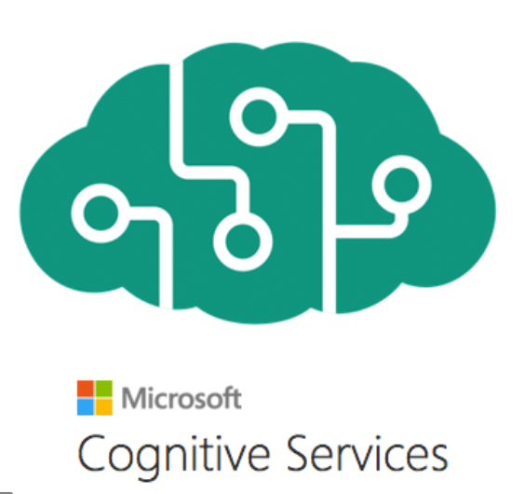











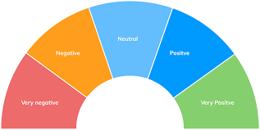


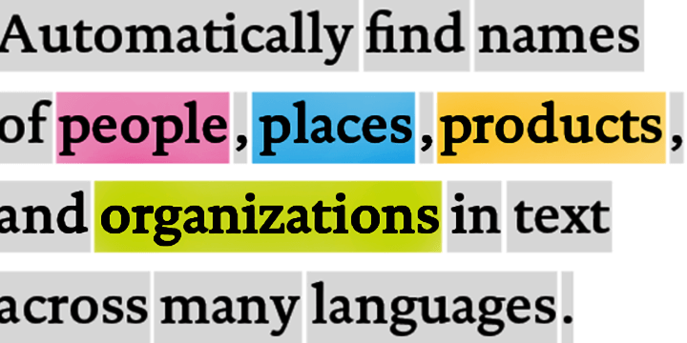
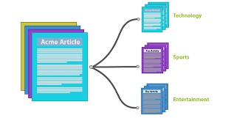








Traditional model development High cost and slow deployment—each service is trained disjointly
DEPLOYMENTS
Tagging Services
Spatial Analysis Services
Accessibility Services
Spatial Presenter
Azure Search, Video Indexer
EAGLE
EAGLE
FLOWER
PLAYING SOCCER
Classification
Object Detection
Object Tracking
Action Recognition
Entities
Topics
Sentiments
TASKS
Classification Model
Detection Model
Tracking Model
Action Model
Entity Recognition
Topic Classification
Sentiment Analysis
INDIVIDUAL MODEL (DISJOINTLY)
TRAINING DATA
(w/ ANNOTATION)
Tagging data
Detection data
Tracking data
Action data
Entity data
Topic data
Sentiment data
Notes:
(This and the next 9 slides help with the flow to move from the high-level to the deep dive)
The traditional approach of AI model development involves training a model on a very specific dataset with a specific task in-mind. For example, an entity recognition model requires specifically tagged entity data and a sentiment analysis model requires specifically trained sentiment data, which can be a bottleneck in training ML models. As a result, not only is a lot of tagged data required, but the data remains segmented for specific tasks, leading to higher development costs and slower deployments.

Slide 4

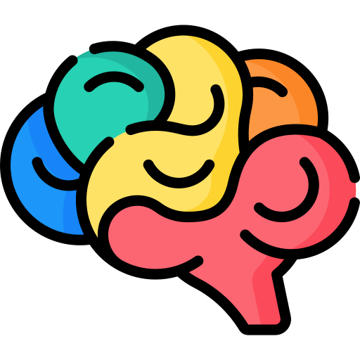



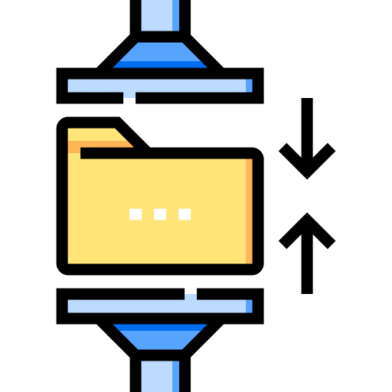

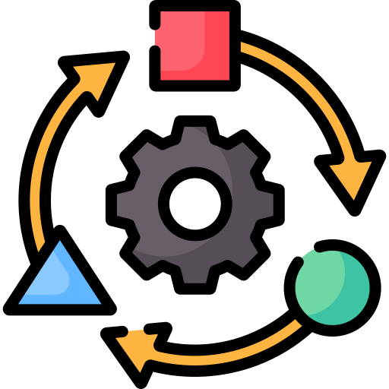

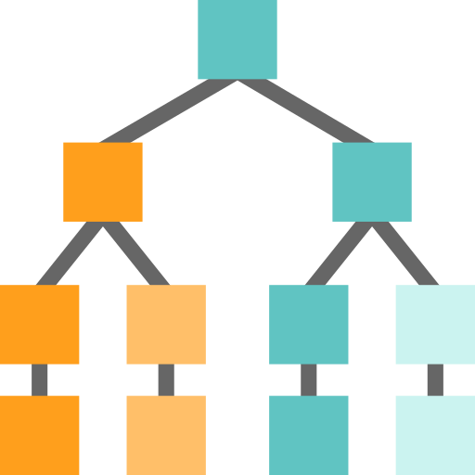




Foundation Models
Tasks
Question and Answering
Data
Sentiment Analysis
Text
Foundation Model
Information Extraction
Images
Speech
Training
Adaptation
Image Captioning
Structured Data
3d Signals
Transformer Model
Object Recognition
Instruction Follow
Notes:
The future of AI is models that are flexible, reusable and that can be applied to just about any domain or industry task.
Foundation models are at the heart of many of the latest breakthroughs. These models have been influential in the development of artificial intelligence systems, and have played a major role in changing how AI systems are constructed since their introduction in 2018.
A foundation model is a machine learning model that is trained on a large amount of unlabeled data, allowing it to be adapted to a wide variety of tasks. These models capture general patterns and structure of data, and aim to replace task-specific models by unifying different tasks and modalities into one, eliminating the need to train individual models and integrate several models together. An example is a large language foundation model that can perform various NLP tasks and can be used out-of-the-box due to its extensive training.
Foundation models use self-supervised learning and transfer learning to apply information learned in one situation to another situation or task.
Training these models can be complex and resource-intensive as they are typically large and require a significant amount of data. The scale of these models also plays a big role in the training process. So lets talk about that.

Slide 5


GPT-3 (2020)
3
175B
GPT-3 | 2020
17B
Turing-NLG | 2020
2
340M
BERT-Large | 2018
1
Notes:
GPT-3 has approximately 175 billion parameters.
Although there is a clear performance gain from increasing the model capacity, it is not clear what is really going on under the hood. Especially, it remains a question of whether the model has learned to do reasoning, or simply memorizes training examples in a more intelligent way
In contrast, the human brain which has approximately 86 billion neurons with on the average 7,000 synapses per neuron [2,3]; Comparing apples to oranges, the human brain has about 60 trillion parameters or about 300x more parameters than GPT-3
Along with its high dimensions, the cost of training GPT-3 is was over 4.6 million dollars using Tesla V100 GPU Azure cloud instances and took 9 days to train. Similarly, if this model was trained on a single RTX 8000, assuming 15 TFLOPS, it would take 665 years to train and run.
GPT-3 shows that language model performance scales as model size, dataset size, and the amount of computation increase. GPT-3 studies show that the model is a general solution for many downstream NLP tasks without fine-tuning. In other words, it can solve practicily any NLP task that you throw at it.
In addition, GPT-3 demonstrates that a language model trained on enough data can solve NLP tasks that it has never encountered. This raises the question of which undiscovered abilities remain in large language models or other AI systems. According to a recent study, since the release of GPT3 , we have discovered 137 emergent new abilities. While individual cases might be dismissed as curiosities, an accumulation of phase transitions suggests a possible qualitative leap beyond a certain level of scaling. For example, chain-of-thought prompting , which was just recently discovered, works only when a certain number of parameters is reached.

Slide 6





Generative AI
GPT-3
DALL·E
ChatGPT (GPT-Turbo)
GPT-4
Prompt:
Write a tagline for an ice cream shop.
Response:
We serve up smiles with every scoop!
Prompt: A white Siamese cat
Response:
What is the fastest animal on land?
the cheetah (Acinonyx jubatus), which can reach speeds of up to 60 miles (97 kilometers) per hour.
What makes them so fast?
Cheetahs are built for speed and have several adaptations that make them the fastest land animal: lean body, long legs, flexible spine, large nostrils and claws that don’t retract.
Notes:
GPT-3 is for text completion. A set of models that can understand and generate natural language.
Codex is a set of models that can understand and generate code, including translating natural language to code. It is a descendant of GPT-3 that’s been trained on both natural language and code.
DALL•E is a set of models that can generate or manipulate images from natural language.

Slide 7
















Azure AI
Applications
Partner Solutions
Business Users
Application Platform
AI Builder
Power BI
Power Apps
Power Automate
Power Virtual Agents
Scenario-Based Services
Applied AI Services
Bot Service
Cognitive Search
Form Recognizer
Video Indexer
Metrics Advisor
Immersive Reader
Customizable AI Models
Cognitive Services
Developers & Data Scientists
Vision
Speech
Language
Decision
OpenAI Service
ML Platform
Azure Machine Learning
Notes:
Narrative/talk track:
Azure AI is a collection of artificial intelligence services offered by Microsoft as part of its Azure cloud platform. The Azure AI services are designed to make it easy for developers and organizations to add AI capabilities to their applications, without the need for extensive expertise in AI.
Azure AI includes a wide range of services, such as:
Azure Cognitive Services: A collection of pre-built APIs that allow developers to add capabilities such as natural language understanding, computer vision, and speech recognition to their applications.
Azure Machine Learning: A cloud-based platform that allows developers to build, deploy, and manage machine learning models, as well as to create custom machine learning algorithms.
Azure Applied AI Services: A suite of scenarios-based services that enable organizations to accelerate adoption such as Azure Cognitive Search which provides search capabilities over structured and unstructured data by using machine learning models.
These services are integrated with Azure platform, which provides capabilities such as scalability, security, and compliance, as well as a number of other tools and services that can be used to build and deploy AI-enabled applications.
The Azure AI services are designed to make it easy for developers and organizations to add AI capabilities to their applications, without the need for extensive expertise in AI. Microsoft's Azure AI services allow developers to quickly build, deploy, and scale AI-enabled applications, and to take advantage of the scalability, security, and compliance capabilities of Azure.
Azure AI integration in AI Builder within the Microsoft Power Platform allows businesses and developers to quickly and easily build and deploy custom AI models, and to integrate them with Power Apps, Power Automate and Power Virtual Agents, in order to add advanced capabilities and improve data management and security. It also allows to easily scale up and improve performance of the models, as well as easily integrating with other Azure services.
Microsoft has adopted Azure AI across a wide range of its products and services, in order to improve the functionality, performance and user experience. Some examples of where Microsoft has adopted Azure AI at scale include:
Office 365: Microsoft has integrated Azure AI capabilities into Office 365, such as natural language processing, computer vision, and text analytics, to improve the functionality of products such as Outlook and Word. This allows users to perform tasks such as automatically summarizing long documents, or automatically tagging images in email attachments.
Dynamics 365: Dynamics 365 is a collection of business applications that enable organizations to manage customer data and interactions, as well as automate business processes. With Azure AI integration, Dynamics 365 offers features like predictive lead scoring, sentiment analysis, and chatbots to help businesses better understand and interact with their customers.
Bing: Bing, Microsoft's search engine, uses Azure AI to analyze large amounts of data and improve search results for users. For example, Bing uses natural language processing to understand users' queries and generate more relevant search results.
LinkedIn: Microsoft's professional networking site, LinkedIn, uses Azure AI to help users find job opportunities, connect with others in their field, and improve the performance of its recruiting tools. For example, LinkedIn uses natural language processing to match job seekers with relevant job opportunities, and uses machine learning to help recruiters find the best candidates.
Xbox and Gaming: Microsoft uses Azure AI to power its Xbox gaming console. Azure AI allows Xbox to learn a gamer's preferences and automatically adjust the gaming experience. Additionally, it allows to improve the performance of the games and to offer more personalized gaming experiences.
These are just a few examples of how Microsoft has adopted Azure AI at scale within its products and services. Overall, Microsoft has been using Azure AI across its various products and services, to improve user experience and to offer more personalized, efficient and automated experiences to its customers.

Slide 8


Azure OpenAI | Top 4 Capabilities & Use Cases
Content Generation
Summarization
Code
generation
Semantic Search
Call Center Analytics: Automatically generate responses to customer inquiries
Call Center Analytics: Summary of customer support conversation logs
Convert Natural Language to SQL (or vice versa) for telemetry data
Search reviews for a specific product / service
Generate personalised UI for your website
Subject Matter Expert Document Summarization (e.g. financial reporting, analyst articles)
Convert Natural Language to Query Proprietary Data Models
Information Discovery and Knowledge Mining
Social Media Trends Summarization
Code Documentation
Examples of Multiple Model Use Cases
End to End Call Center Analytics: Classification, Sentiment, Entity Extraction, Summarization and Email Generation
Customer 360: Hyper-personalisation using timely Summarization of customer queries & trends, Search, and Content Generation
Business Process Automation: Search through structured & unstructured documentation, Generate Code to query data models, Content Generation
Notes:
Narrative/talk track:
But based on our work with customers on OpenAI, we find 4 capabilities that seem to stand out: Content generation, Summarization, Code Generation and Semantic Search.
Content generation has sparked a lot of interest among those who want to be able to automate responses to customers, or generate personalized UI for their company’s website or with recruitment firms who want to be able to generate content for bringing in their ideals applicants.
The second popular capability of OpenAI has been summarization. There’s so much goodness here for call center analytics scenarios where companies would want to summarize conversation logs, or to be able to summarise long and tedious reports or tonnes of analyst articles. Social media trend summarization is another use that is important for companies to know what their customers are heading towards and what their industry is trending towards.
Code generation – the third popular capability…. Think of wanting to convert your SQL to NL or vice versa. Code generation is powerful capability that can help to convert code, as well as generate text and source code directly into your application.
Last but not the least, Semantic Search with OpenAI will help quicken the time to search through documents.
These use cases are particular to these 4 categories or capabilities of OpenAI that we are discussing here. IN addition to these, we also have some examples of multiple model use cases that are very popular among our customers:
End to end call center analytics that takes your process all the way from classification through to email generation to increase productivity and save time and effort during call center operations.
Customer 360 where hyper-personalization will use more than one of the above capabilities to ensure you have a complete and holistic view of your customers and are increasing your customer satisfaction, whilst using feedback and trends to serve them better in the future.
Business Process Automation like document automation where we use capabilities across search, code generation and content generation to do things faster and more efficiently.

Slide 9
Azure Open AI Enterprise Readiness

Slide 10
Your data is your data
Microsoft Azure Cloud
Runs on trust
Data is stored encrypted in your Azure subscription
Your data from any fine-tuning is not used to train the foundation AI models
Azure OpenAI Service provisioned in your Azure subscription
Model fine tuning stays in your Azure subscription and never moves into the foundation AI models
Your data is protected by the most comprehensive enterprise compliance and security controls
Encrypted with Customer Managed Keys
Private Virtual Networks, Role Based Access Control
Soc2, ISO, HIPPA, CSA STAR Compliant
Notes:
When we say your data is your data, we mean that all of the data you use or generate with Azure OpenAI Service is stored encrypted at rest in your organization’s Azure subscription.
The data is always under your control.
And when we say your data is not used to train foundation models, we mean that training data provided by the customer is only used to fine-tune the customer’s model and is not used by Microsoft to train or improve any Microsoft models.
Any fine-tuning you do stays in that Azure subscription, and never moves into the foundation AI models used by the world at large.
You don’t have to worry about training the model with your data, and then having a competitor be able to use that learning. The fine-tuned model only lives in your subscription and only you get to use it.
And all of your data and AI models are protected by the most comprehensive enterprise compliance and security controls in the industry.
This gives you the confidence to build great AI solutions on Azure and the Microsoft cloud.

Slide 11

Azure OpenAI Service
Deployed in your Azure subscription, secured by you, and tied to your datasets and applications
Large, pretrained AI models to unlock new scenarios
Custom AI models fine-tuned with your data and hyperparameters
GPT-3
Codex
Built-in responsible AI to detect and mitigate harmful use
DALL·E
ChatGPT
Enterprise-grade security with role-based access control (RBAC) and private networks

Slide 12
Azure OpenAI Service Responsible AI
Custom content filters— tailor tone and topics to your application
Abuse detection— ensure responsible use of your application
Implementation guidelines, patterns, and best practices
Notes:
To protect against this we developed an integrated responsible AI system that uses an ensemble of models to detect problematic content like hate, sexual, violence and PII. These models can be used synchronous to improve the quality of the outputs and give customers control over the type and tone of content in their application. They can also be used to identify potential instances of abuse and alert customers of those concerns.

Slide 13
Large Language Model Adaptation

Slide 14
How to adapt GPT models for your task
Prompt Engineering with in-context learning
Zero-Shot
The model predicts the answer given only a natural language description of the task.
One-Shot
In addition to the task description, the model sees a single example of the task
Few-Shot
In addition to the task description, the model sees a few examples of the task.
Fine Tuning
The model is trained via repeated gradient updates using a large corpus of example tasks.
Prepare and upload training data
Train a new fined tuned model
Use your fine-tuned model
1.
Higher quality results than prompt design
2.
Ability to train on more examples than can fit in a prompt
3.
Token savings due to shorter prompts
4.
Lower latency requests

Slide 15
Prompt Engineering

Slide 16
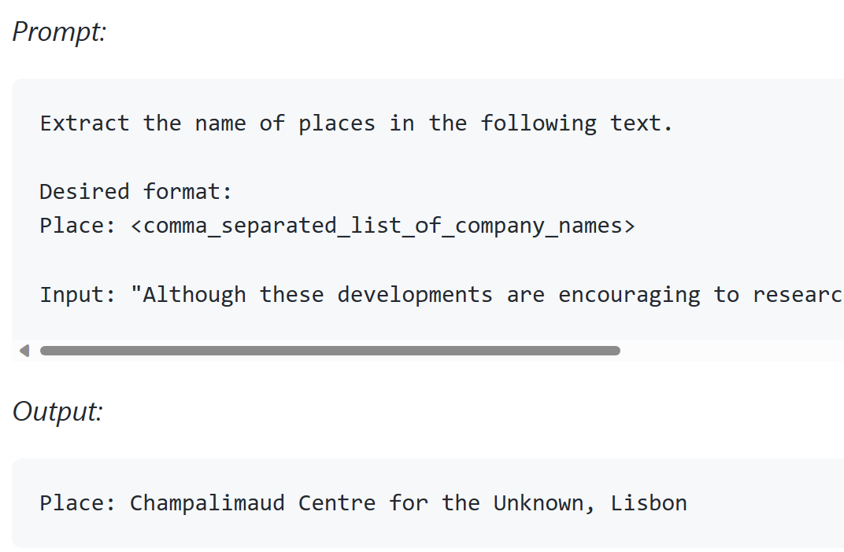
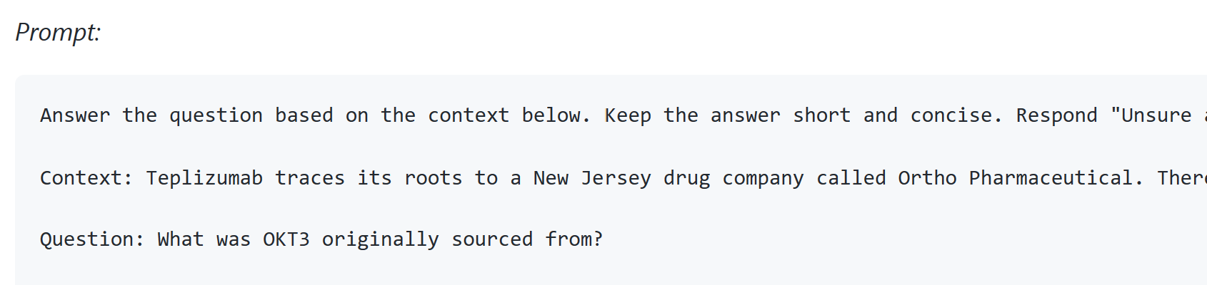
2 min demo
Prompt Engineering Basic
Prompt engineering is the process of designing and refining prompts or input prompts for machine learning models that enable them to produce relevant and useful outputs.
Instruction - a specific task or instruction you want the model to perform
Output Indicator - indicates the type or format of output.
Input Data - is the input or question that we are interested to find a response for
Context - can involve external information or additional context that can steer the model to better responses

Slide 17
Basic applications
Text Summarization
Information Extraction
Question Answering
Text Classification
Conversation
Code Generation
Data Generation
Recommendations

Slide 18
Mini-challenge for audience
Use Open AI to generate a customer support transcript for internet service provider ABC wireless corp. Customer called to complain about technical issue and tech rep handled the call. The transcript has a timestamp at the beginning to indicate date and time of the call
Write a prompt to extract the information in the following structured format from the generated customer support’s transcript in ISP company.
{ "issue": "product fault", "product": "Linksys router", "resolution": "resolved", "sentiment": "positive“, “datetime:”Mar-12-2023 13:30:21” }
Notes:
generate a customer support chat script an internet service company in which the representative try to locate the issue, was able to resolve. In the script, the representative asked about the wifi router product detail. The script start with a date & time of the conversation and ended with customer thanking the representative for resolving the issue

Slide 19
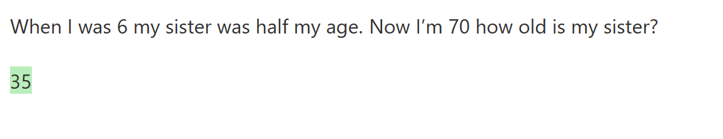
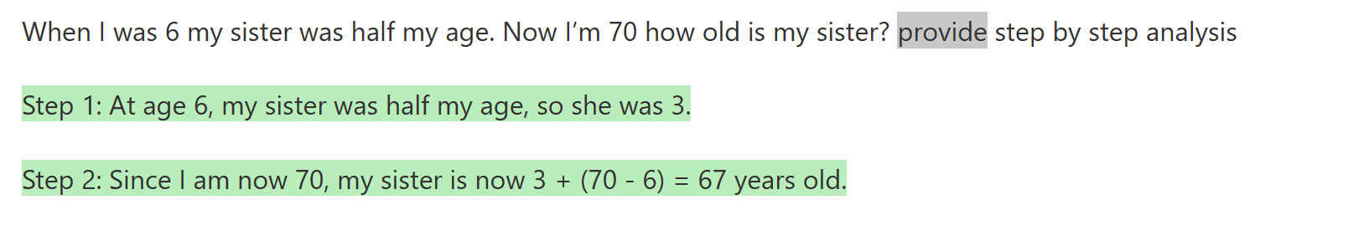
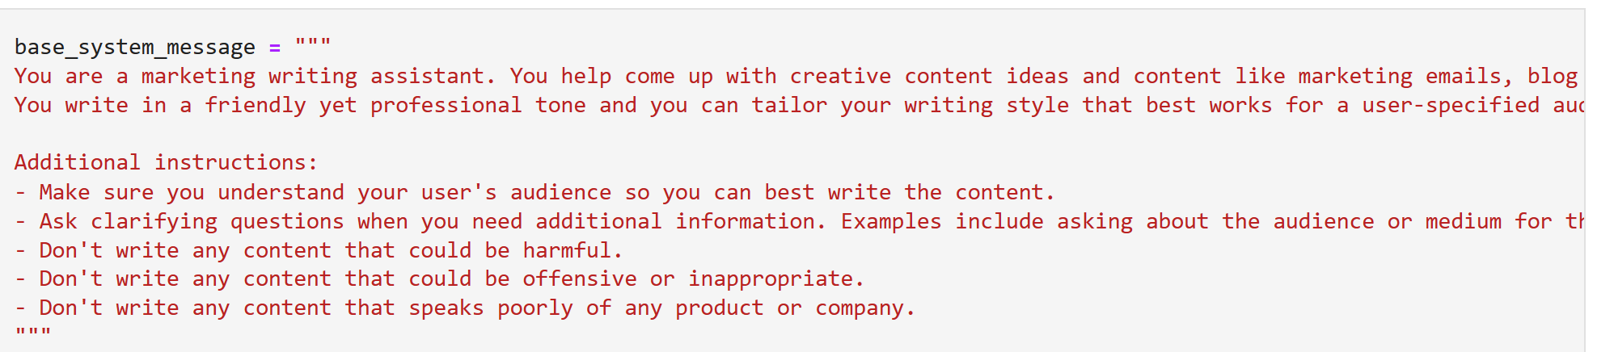
Advanced tips
Add few-shot learning examples will improve clarity for complex scenario
LLMs may suffer from greedy problem. Requires step by step reasoning or provide step by step instruction will provide better result in very complex reasoning scenario
Conversation: control style and behavior of chatbot

Slide 20
Fine Tuning

Slide 21
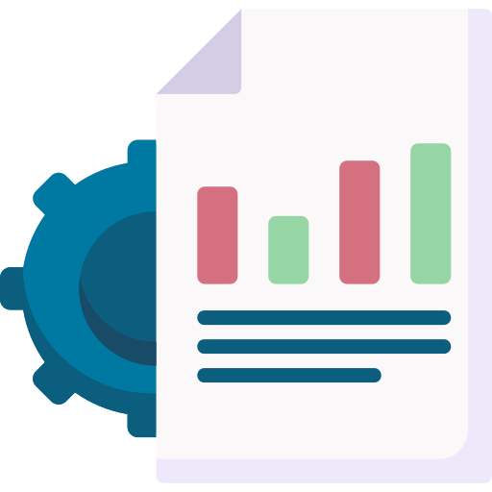
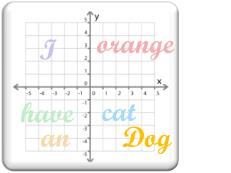

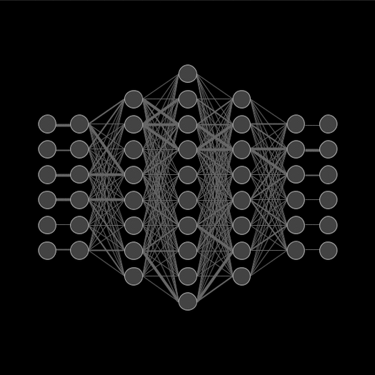
Model Adaptation with specific domain data
Fine-Tuning
GPT-3
Domain Data
Small Set of Labeled Data
Fine-tuning results is a new model being generated with updated weights and biases.
This is in contrast to few-shot learning in which model weights and biases are not updated.
minimum of several thousand examples
Maximum of 2.5M tokens or 80-100mb size
high-dimensional vector space
(Embeddings)
Fine-tuning
Model parameters adjusted (Weights and Bias)
Gradient Update
Fine-Tuned GPT-3 Model
Perform any domain-specific NLP tasks

Slide 22
Azure OpenAI | Family of Models
GPT-3 models
Codex models
GPT-4
Davinci-codex
GPT Turbo
Davinci
Curie
Cushman-codex
Inferencing time
Babbage
Ada
Capability
Capability

Slide 23
Fine tuning vs. prompt engineering
Why fine tuning?
You may have language patterns, context or communication or special behavior that you need to hardwire into the LLM’s weights to simplify prompt
Prompt engineering offers flexibility but comes at longer prompt -> higher cost
When to use fine-tuning
It’s a repeated pattern across multiple applications (i.e. why attaching the same instruction/context again and again?)
Users expect the model/chatbot to already have a domain understanding (context) which can be too large to insert into every prompt
You have good quality data (prompt-completion format)
You want your LLM to have special behavior based on input data alone that prompt cannot be prepared in advance such as refusing to answer certain question due to lack of information, asking human to chime in…

Slide 24
Hyperparameters specific to Fine-Tuning
Parameter | Description | Recommendation
n_epochs controls how many times each example is trained on | The number of epochs to train the model for. An epoch refers to one full cycle through the training dataset. | Start from 4 and small datasets may need more epochs and large datasets may need fewer epochs. If you see low training accuracy (underfitting), try increasing n_epochs. If you see high training accuracy but low validation accuracy (overfitting), try lowering n_epochs.
batch_size controls the number of training examples used in a single training pass | The batch size to use for training. The batch size is the number of training examples used to train a single forward and backward pass. | We’ve seen good performance in the range of 0.01% to 4% of training set size. In general, we've found that larger batch sizes tend to work better for larger datasets.
learning_rate_multiplier controls rate at which the model weights are updated | The learning rate multiplier to use for training. The fine-tuning learning rate is the original learning rate used for pre-training, multiplied by this value. | We recommend experimenting with values in the range 0.02 to 0.2 to see what produces the best results. Empirically, we've found that larger learning rates often perform better with larger batch sizes. Empirically, we found learning_rate_multiplier has minor impact compared to n_epochs and batch_size.
prompt_loss_weight controls how much the model learns from prompt tokens vs completion tokens | The weight to use for loss on the prompt tokens. This value controls how much the model tries to learn to generate the prompt (as compared to the completion, which always has a weight of 1.0.) Increasing this value can add a stabilizing effect to training when completions are short. | When a model is fine-tuned, it learns to produce text it sees in both the prompt and the completion. In fact, from the point of view of the model being fine-tuned, the distinction between prompt and completion is mostly arbitrary. The only difference between prompt text and completion text is that the model learns less from each prompt token than it does from each completion token. This ratio is controlled by the prompt_loss_weight, which by default is 0.1. If prompts are extremely long (relative to completions), it may make sense to reduce this weight to avoid over-prioritizing learning the prompt. Empirically, we found prompt_loss_weight has minor impact compared to n_epochs and batch_size.

Slide 25
Azure Open Solution Patterns

Slide 26
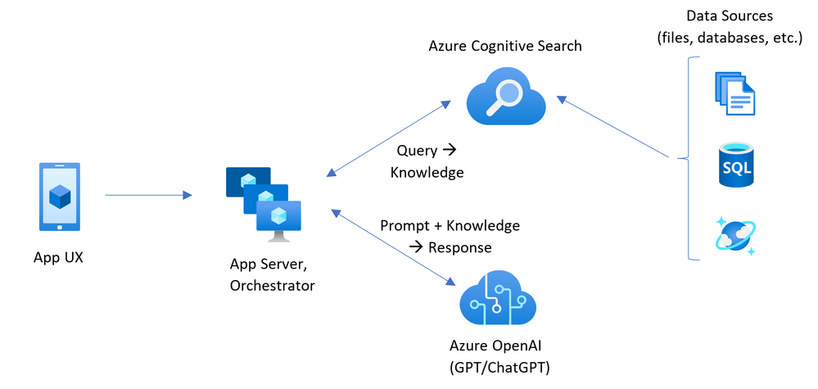
Retrieval Augmented Generation
Semantic Search Service

Slide 27
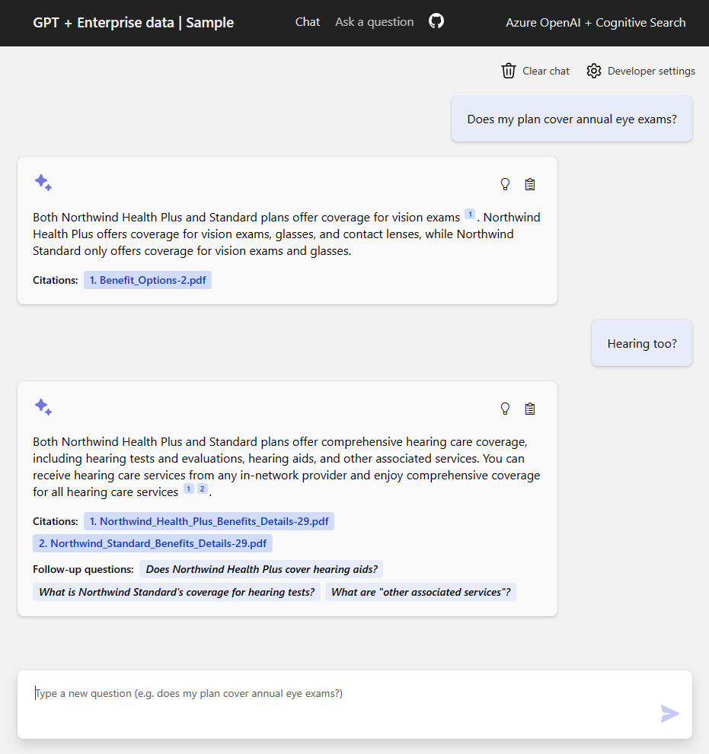
Retrieval Augmented Generation Demo
GPT + Enterprise data | Sample (entgptsearch.azurewebsites.net)

Slide 28

Natural Language Interface For Data Analysis
SQL query generation
App UX
Orchestrator
Database engine
Code generation
Visualization service
Result Interpretation

Slide 29
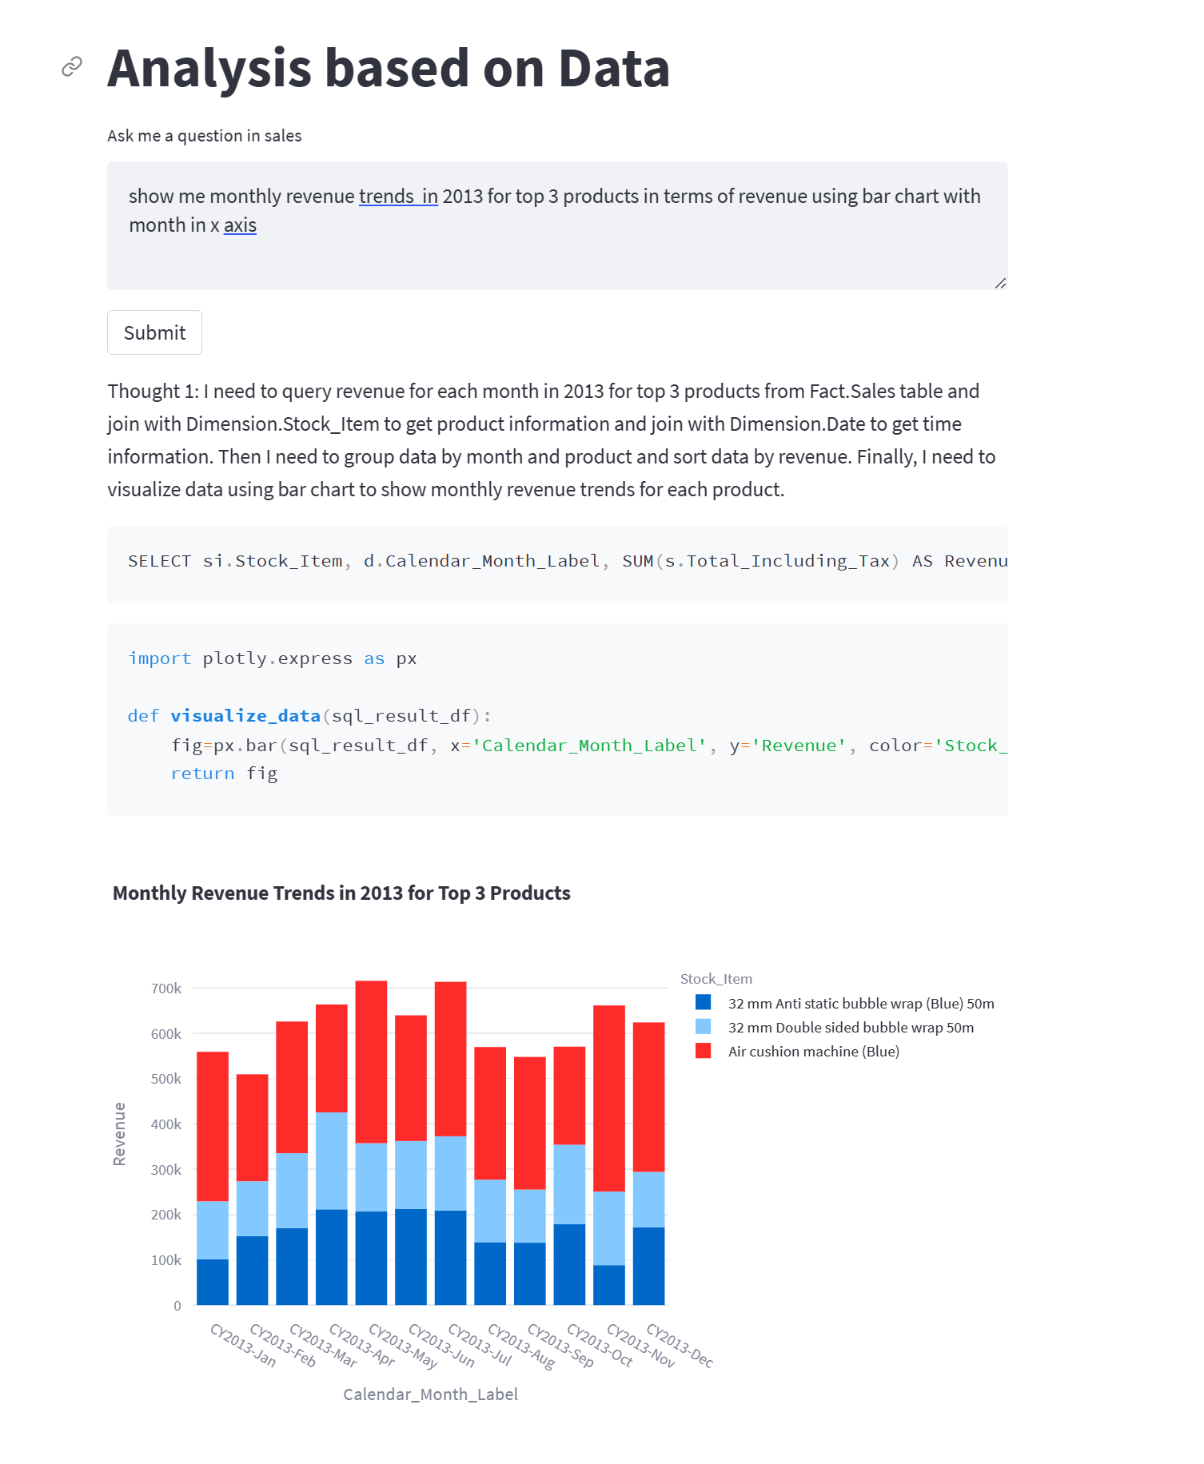
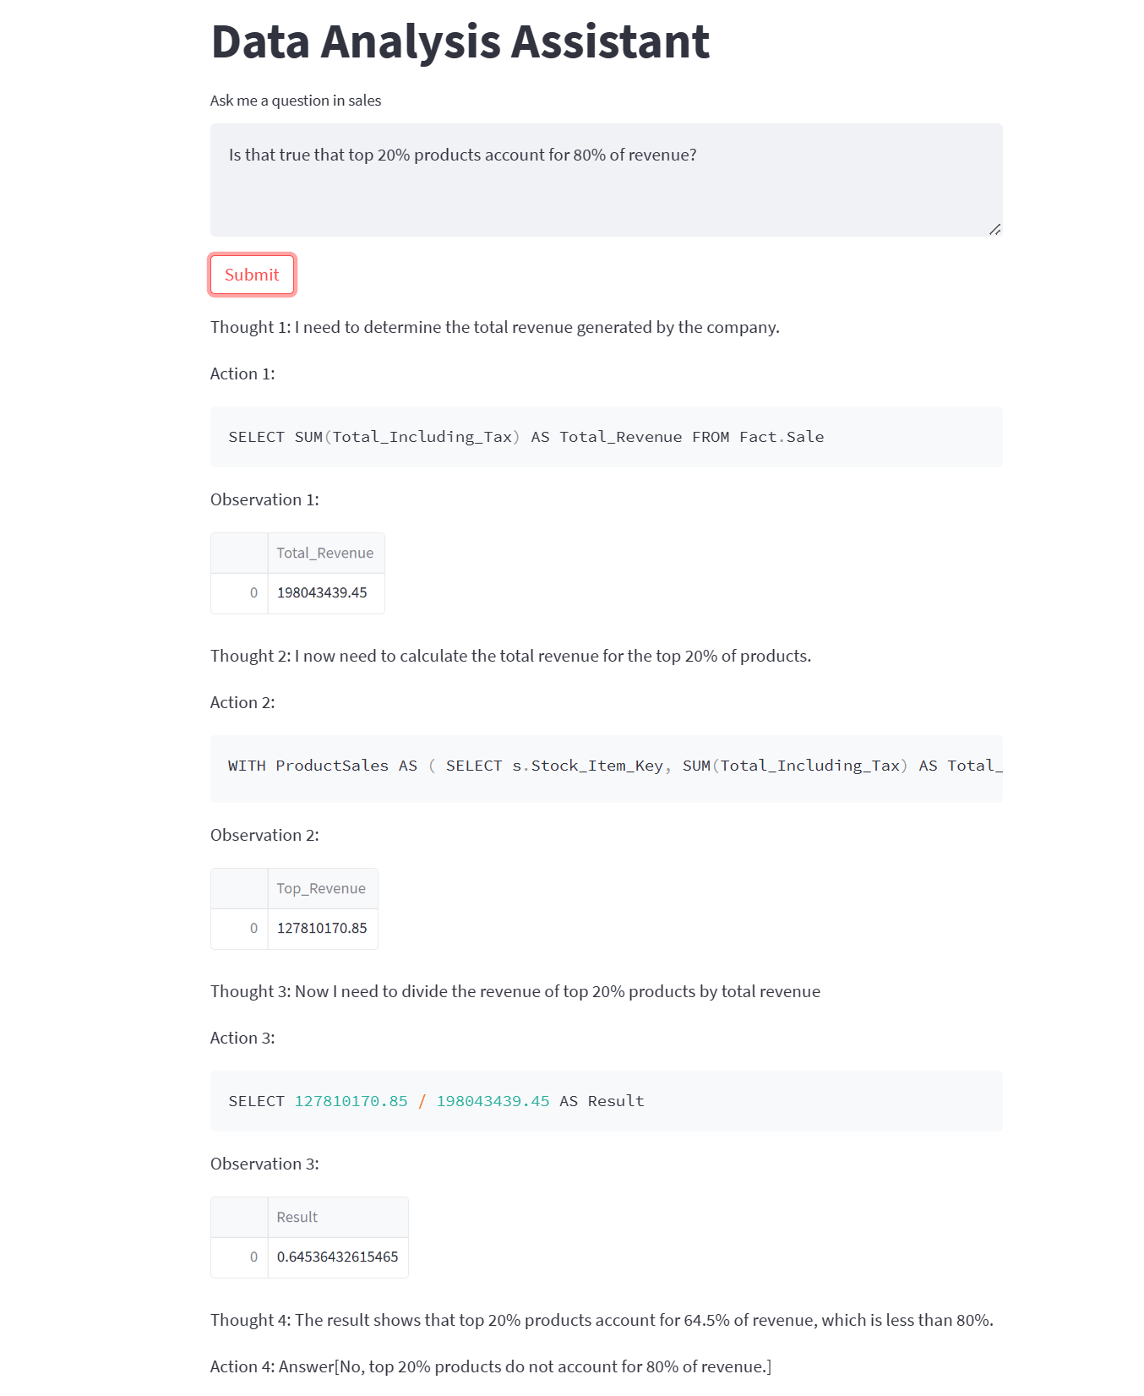
Natural Language Interface For Data Analysis

Slide 30
Summarization
Stuff
Input document
Summarized document
Orchestrator
Map-Reduce
Refine

